Slide 1

Group Members:-
Pratik Shelke
Nachiket Hangekar
Chaitanya Pabale

Slide 2
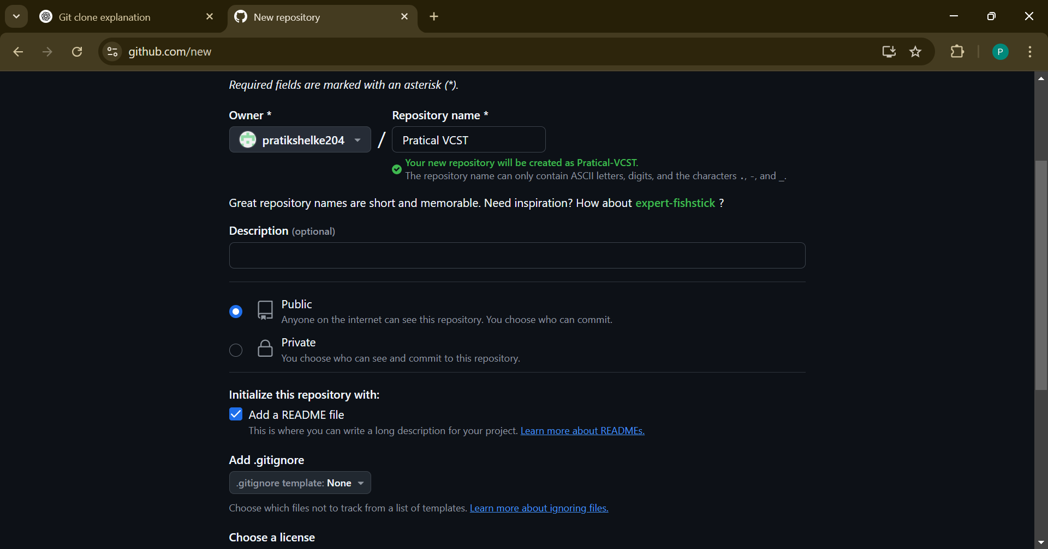
1.create repo

Slide 3
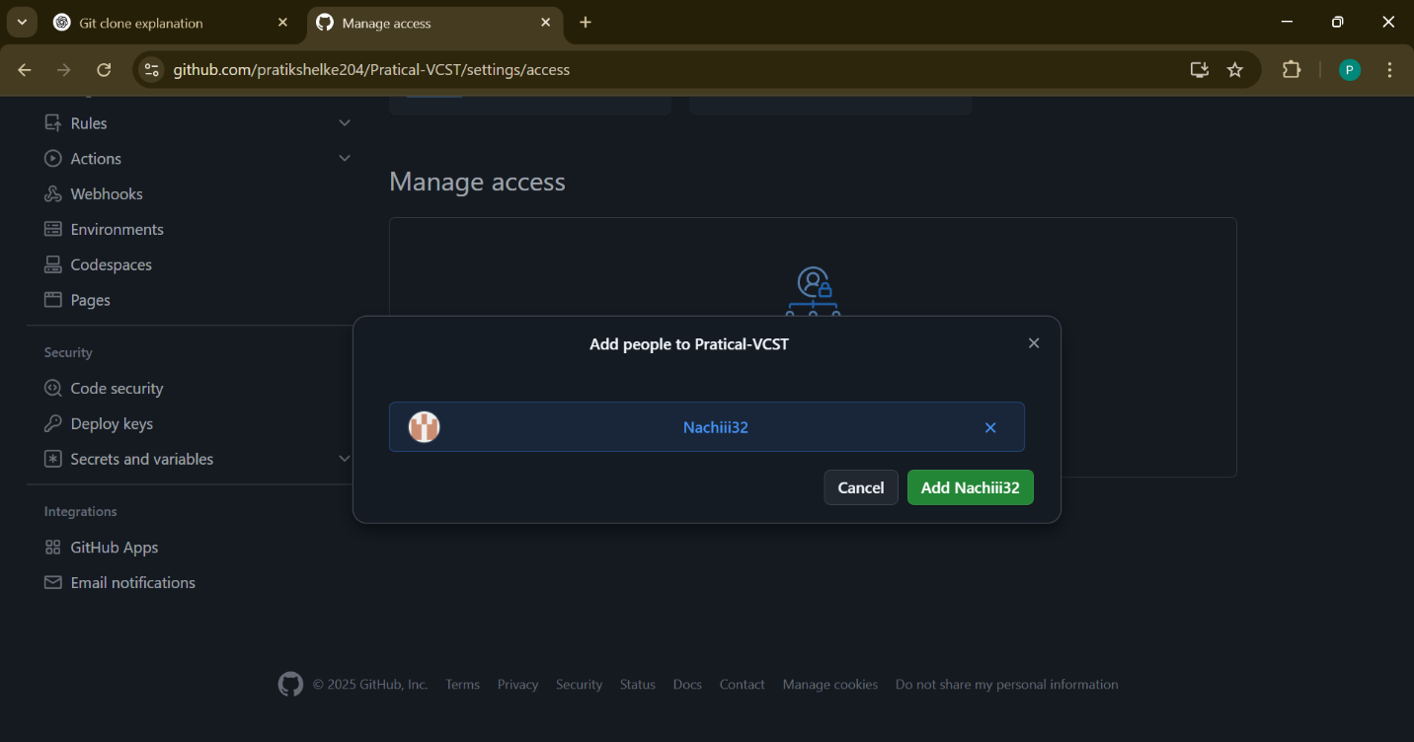
2 . Invite collaboration

Slide 4
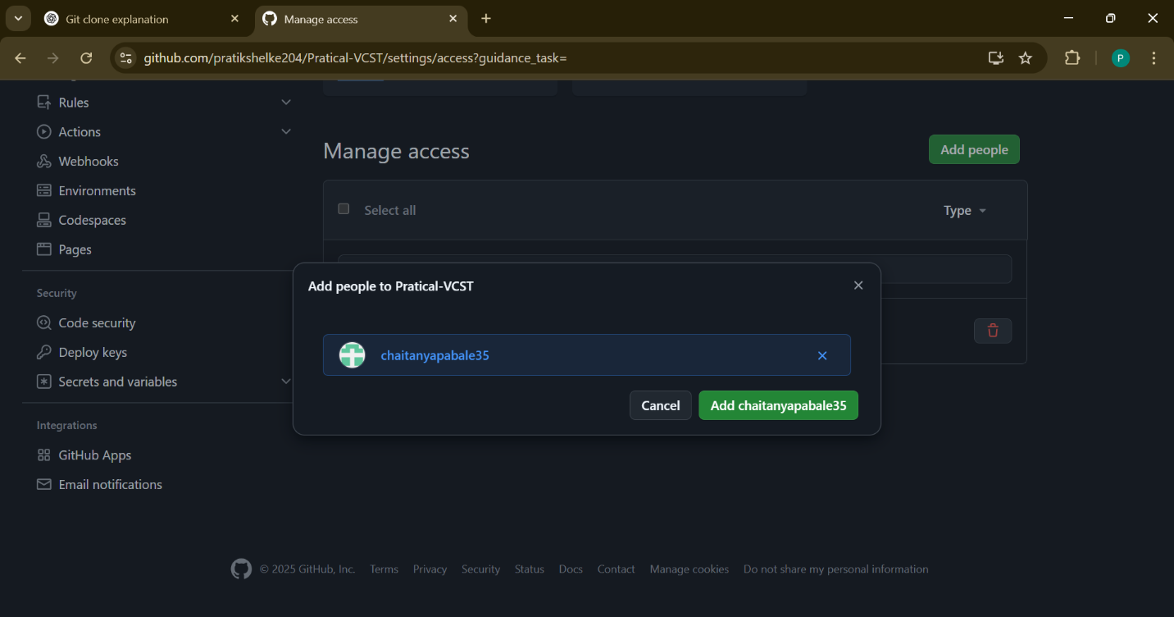

Slide 5
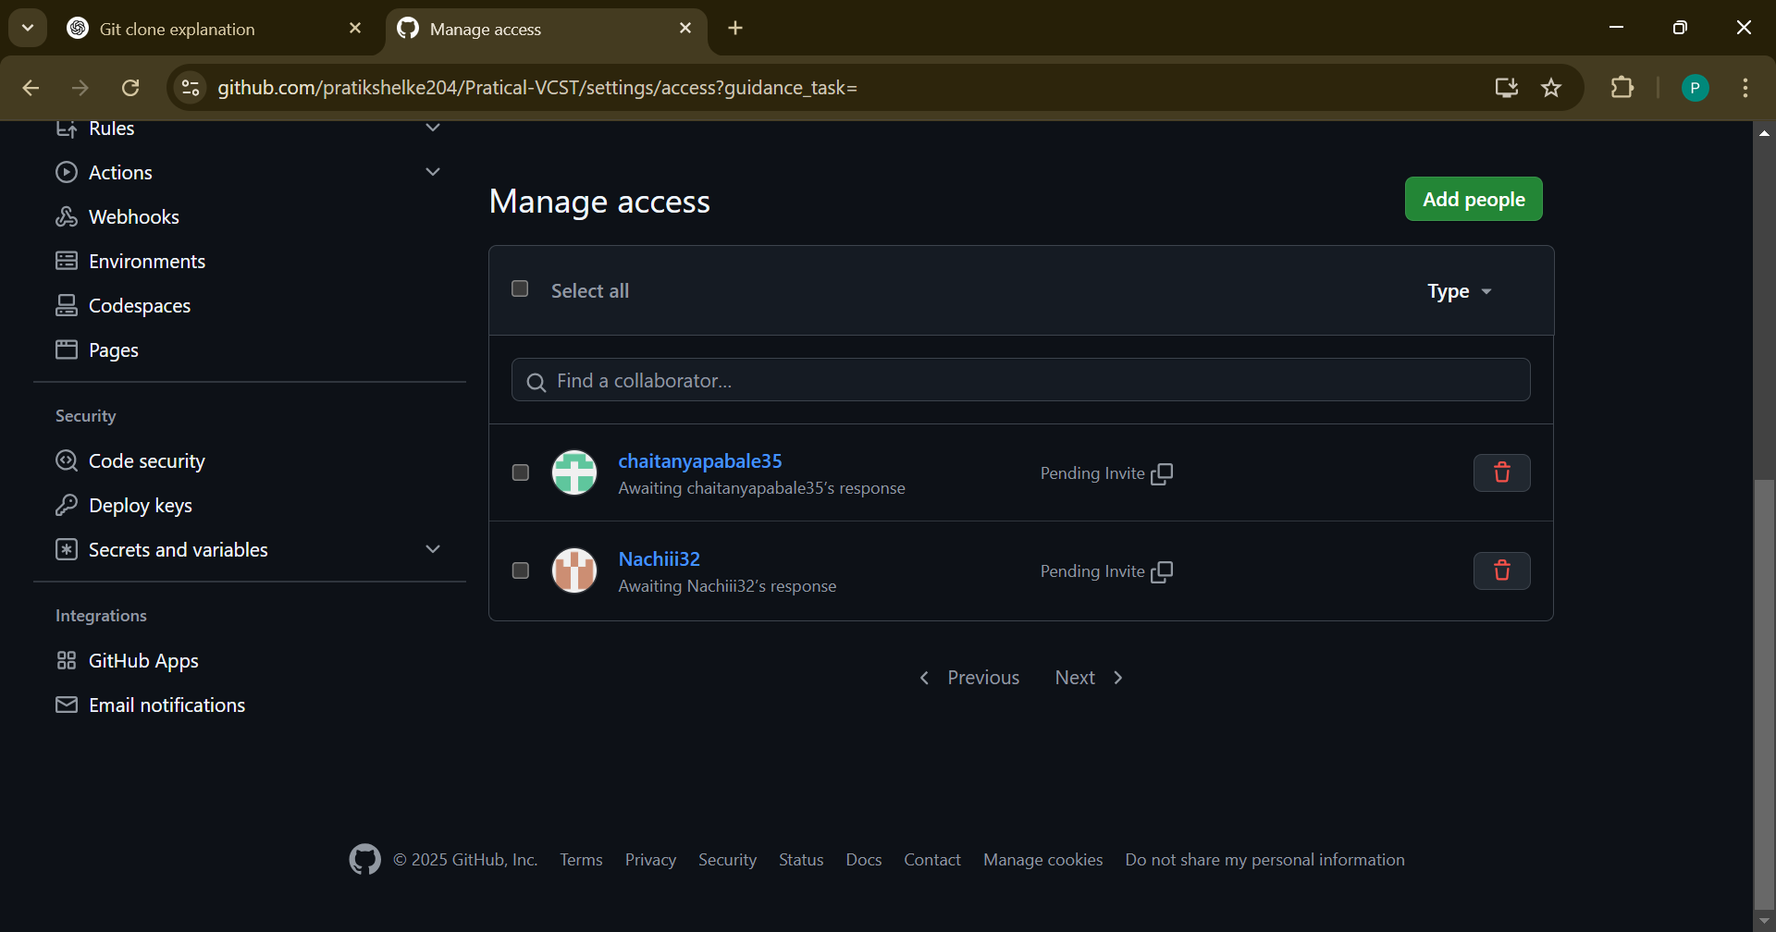
3.Waiting

Slide 6
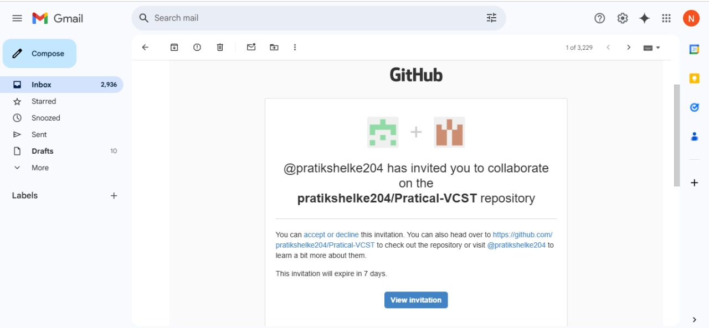
4.Acceted by collaborator

Slide 7
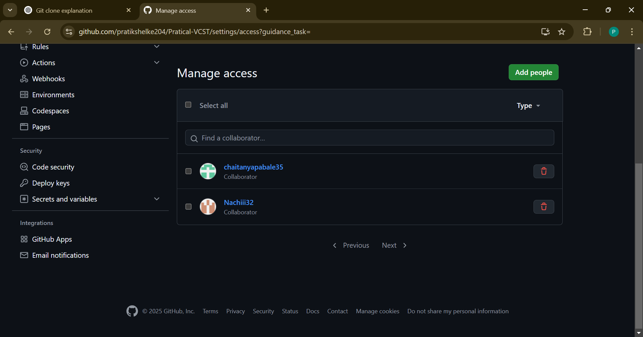
4.Collabrated

Slide 8
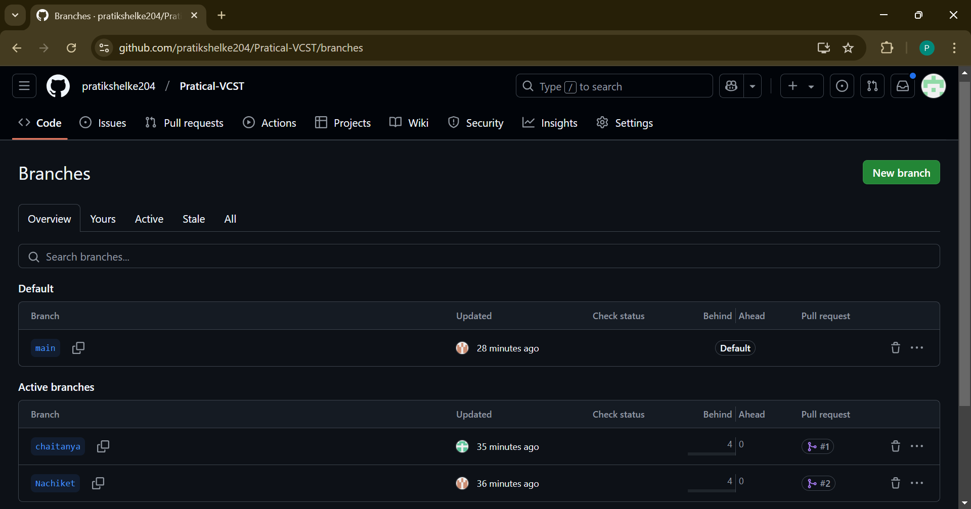
5.Creating branch by each collaborator

Slide 9
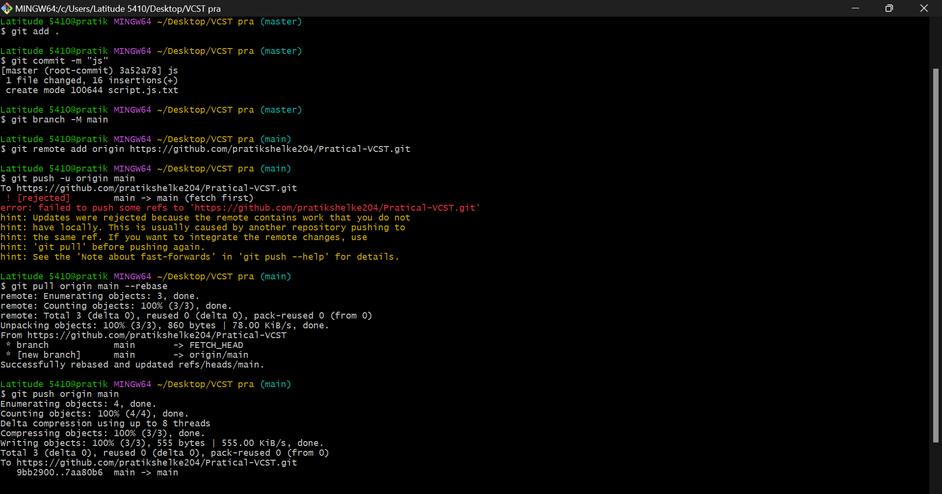

Slide 10
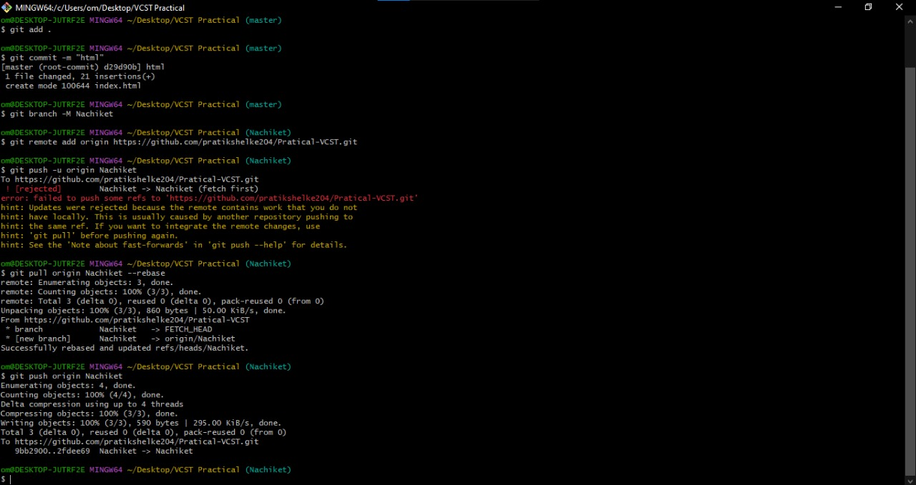
7.Pushing file in ‘Nachiket’ branch

Slide 11
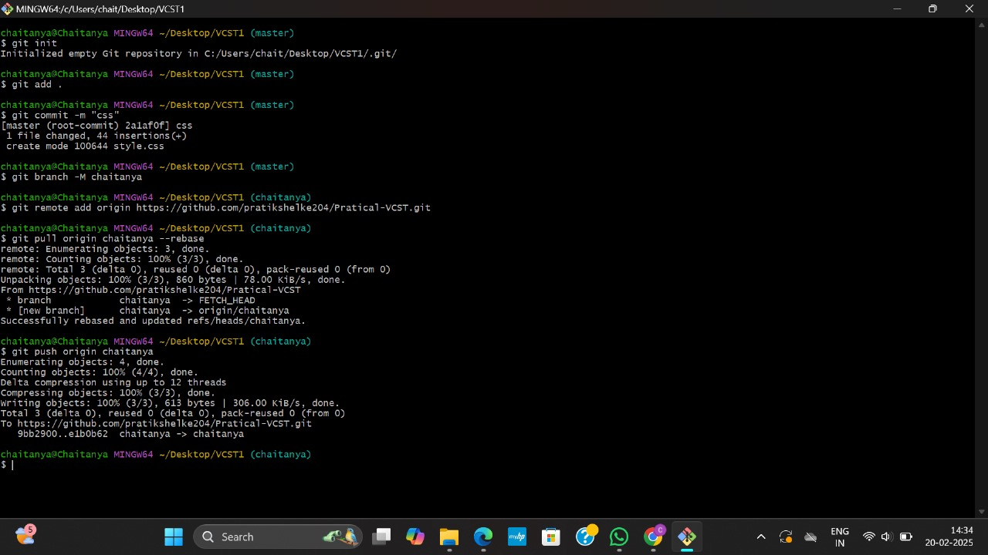
8.pushing file in ‘chaitanya’ branch

Slide 12
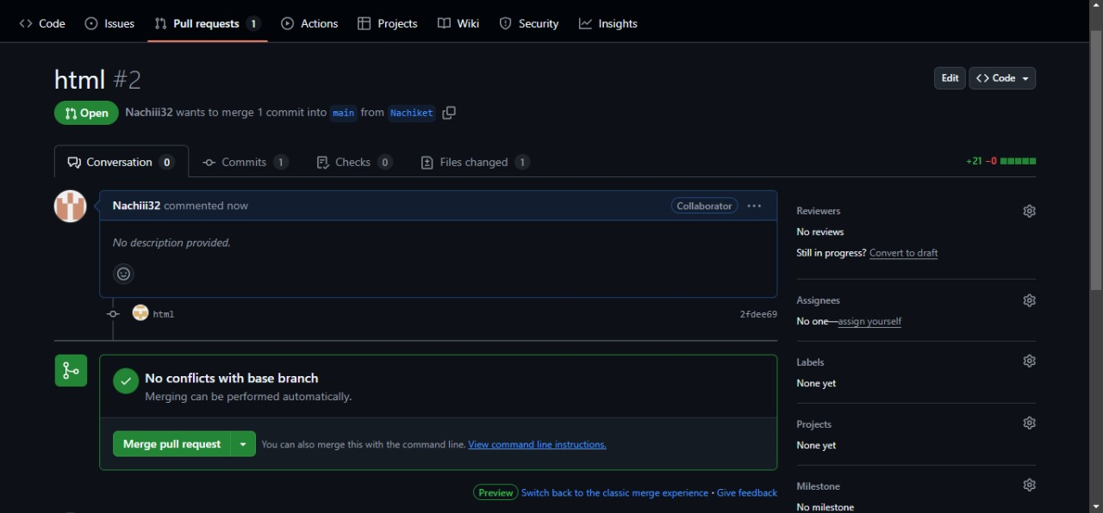
9.Merging all branches

Slide 13
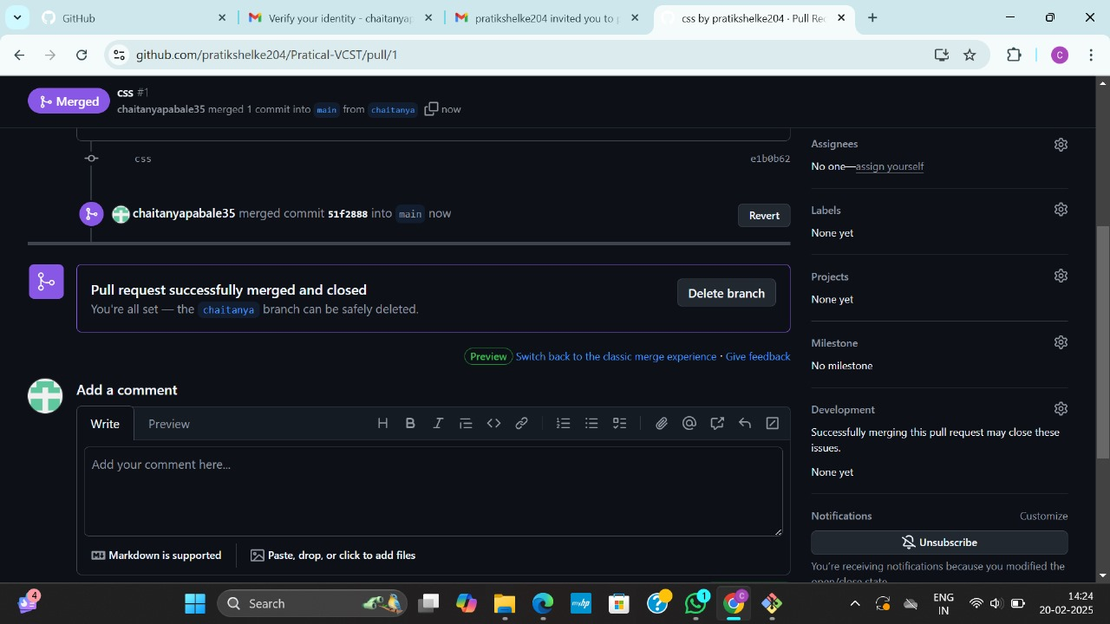

Slide 14
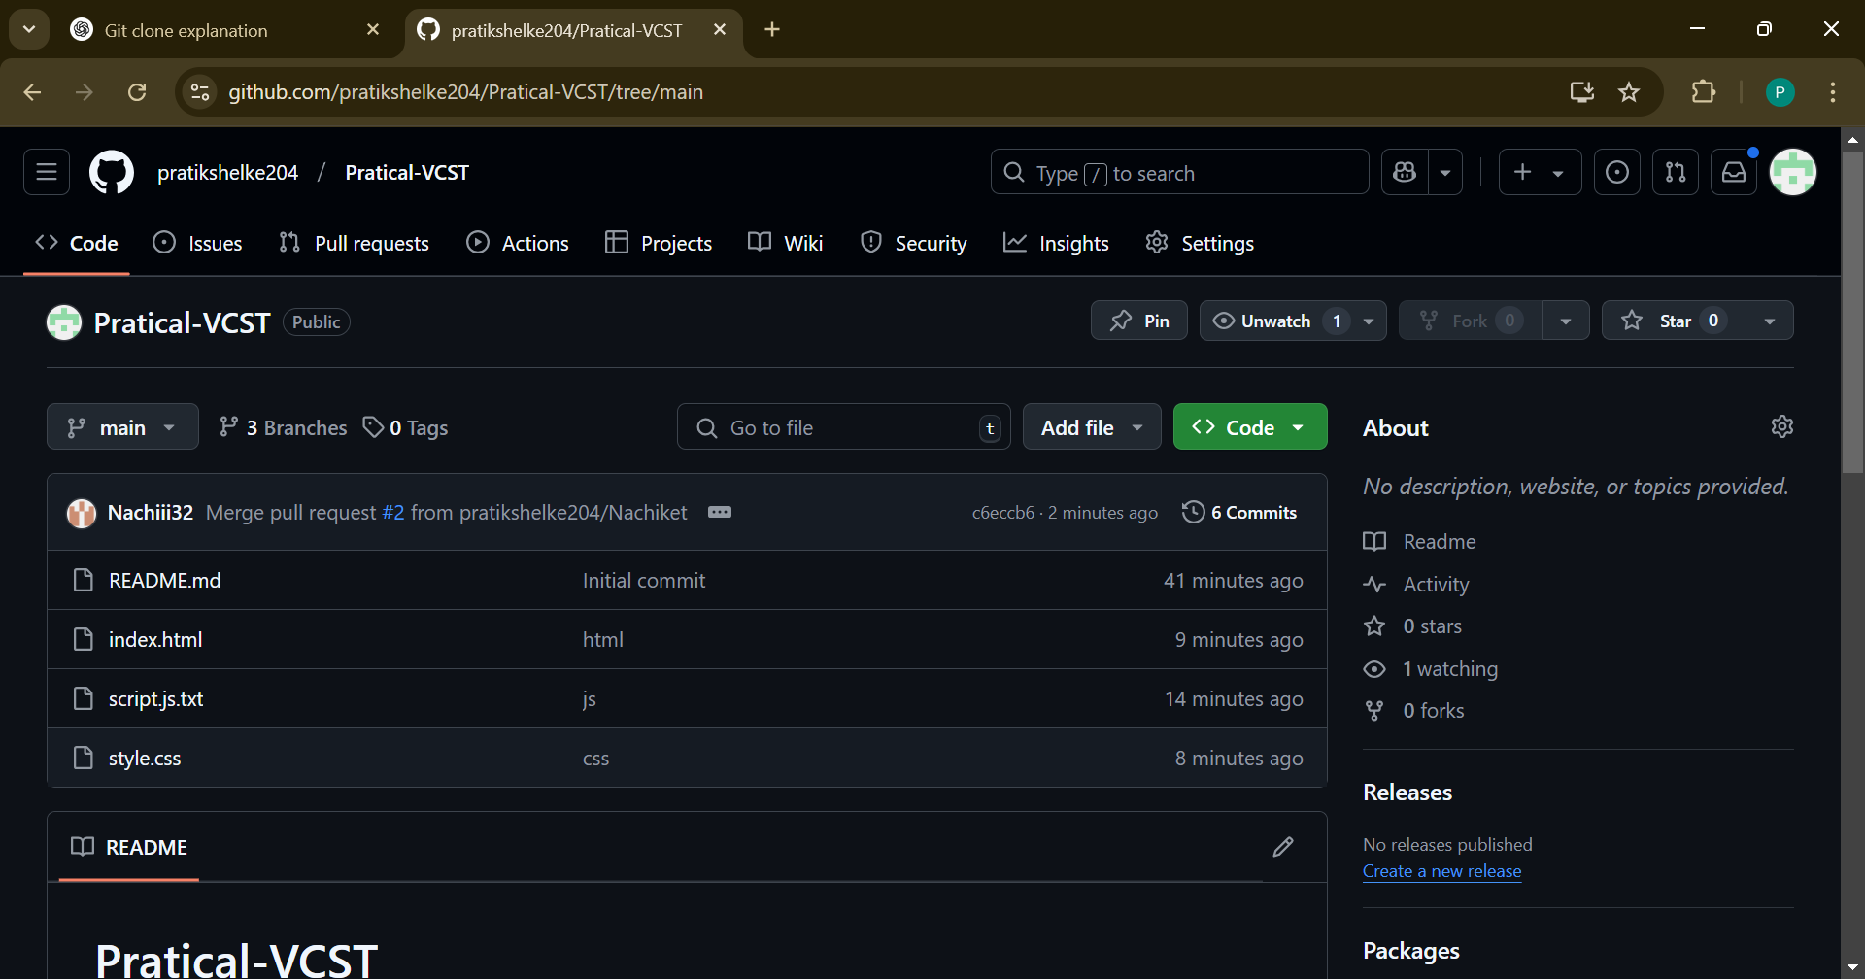
10.After merging All branches

Slide 15
THANK YOU

